Slide 1
Capstone project
Machine Learning Fundamentals
Vladimir Roudko
04/20/2019

Slide 2
Table of contents
Exploration of the Dataset
Augmenting the Dataset
Questions to answer
Classification and Regression Approaches
Conclusions/Next steps

Slide 3
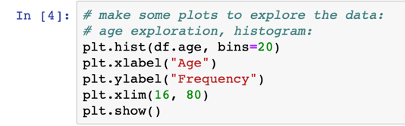
Exploration of the Dataset. Age.
Reading the data:
Insight: majority of participants are in 25 – 35 year old range.
Here is the code:

Slide 4
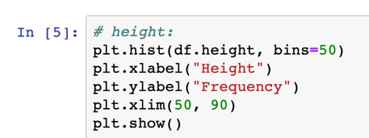
Exploration of the Dataset. Height.
Insight: majority of participants are in 60 – 75 inch height.
Here is the code:

Slide 5
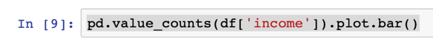
Exploration of the Dataset. Income.
Insight: majority of participants do not disclose their income (-1).
Here is the code:

Slide 6
Exploration of the Dataset. Body type.
Insight: majority of participants want to believe their weight is normal☺.
Here is the code:

Slide 7
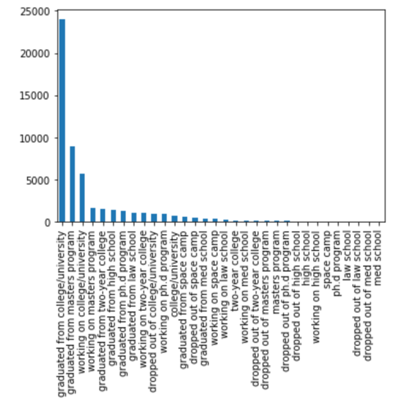
Exploration of the Dataset. Education.
Insight: majority of participants have some level of college degree.
Here is the code:

Slide 8
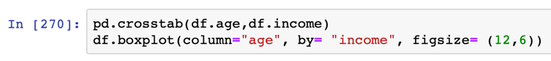
Exploration of the Dataset. Age vs Income.
Insight: Median age of participants gradually increases in $20000 - $250000 income groups. Age of high earners (>=$500000) is clearly falls out of trend and tend to be younger then average. I found it is quiet interesting: either it means that high earners are:
children of wealthy people;
talented “tech” prodigies/startupers – taking into account that majority of profiles are from SanFran bay area;
liars about age or liars about income. Either youngsters trying to impress community with fake deep pocket or rich oldies looking for an adventures☺
Code I used:

Slide 9
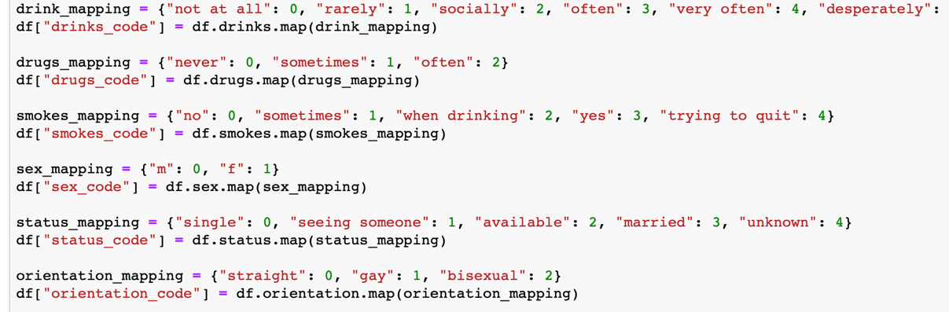
Augmenting data. Drink/drugs/smokes/sex/status/orientation mapping
Mapping of these categories is straightforward
Here is the code:

Slide 10
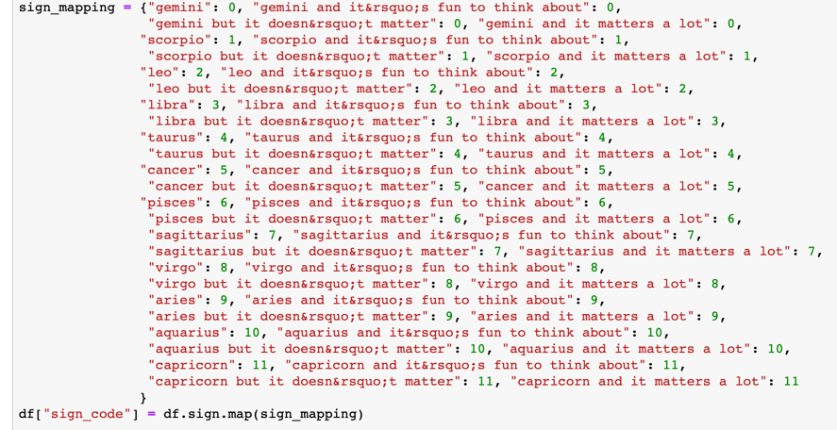
Augmenting data. Sign mapping
Different categories are mapped according to the sign, disregard to subjective feeling about it.
Here is the code:

Slide 11
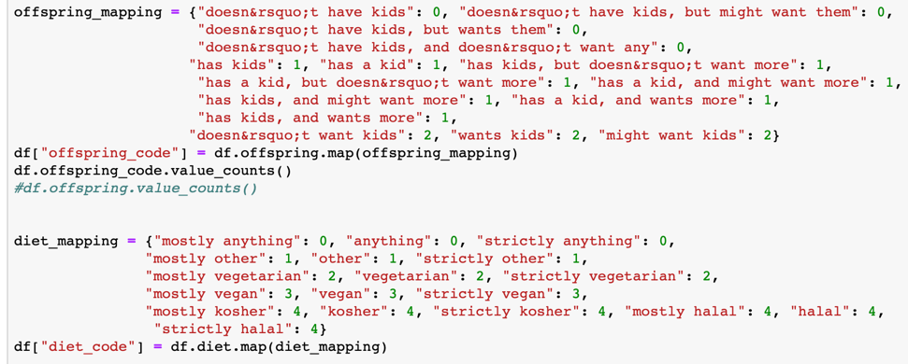
Augmenting data. Offspring and diet
Offspring mapped weather participants does not have kids (0), have kid(-s) (1), or if the status is unclear (2);
Diet is mapped according to participants food choices. Halal and Kosher are grouped together due to low number of counts in these categories

Slide 12
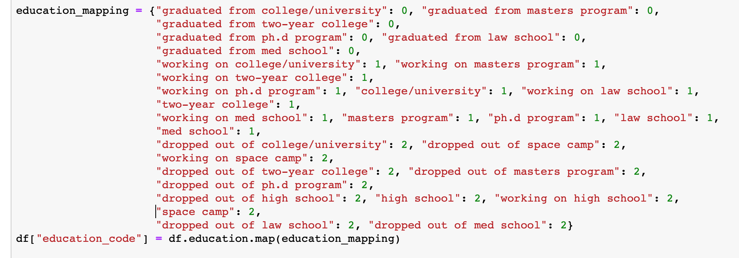
Augmenting data. Education
Mapping is done on 3 categories: has some college degree (0), has some school education (1), dropped out of anything or doing space-camp stuff (3)

Slide 13
Augmenting data. Ethnicity
Mapping is done on 6 categories: white (1), asian (2), indian (3), hispanic/latin (4), black (5), and all others (0).
Code is too long to represent here.

Slide 14
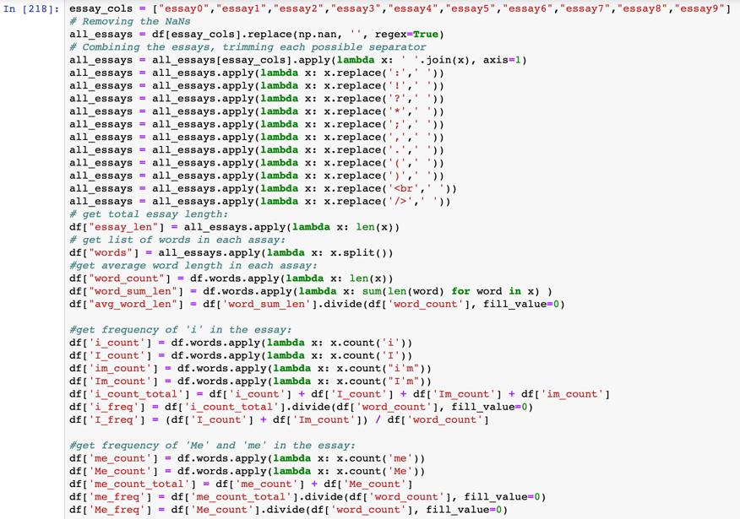
Augmenting data. Essay statistics.

Slide 15
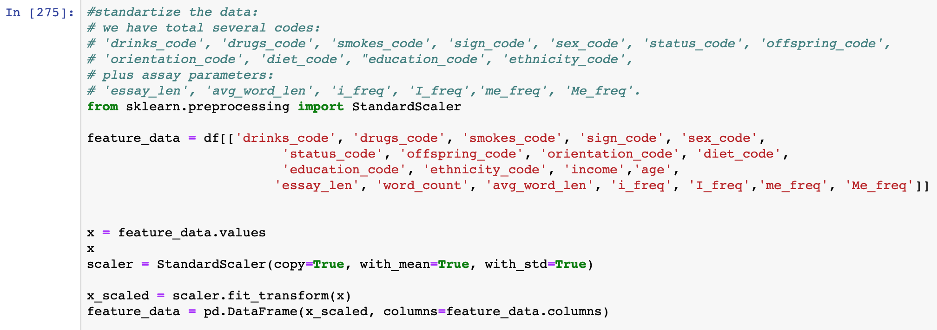
Augmenting data. Standardization
I decided to do both, standardization (x – mean)/sigma and min-max normalization. Normalization was done only for Naïve Bayes classification as it deals only with non-negative features. I found in general results with standardization more reliable and convincing then with normalization, perhaps due to outlier effect.

Slide 16
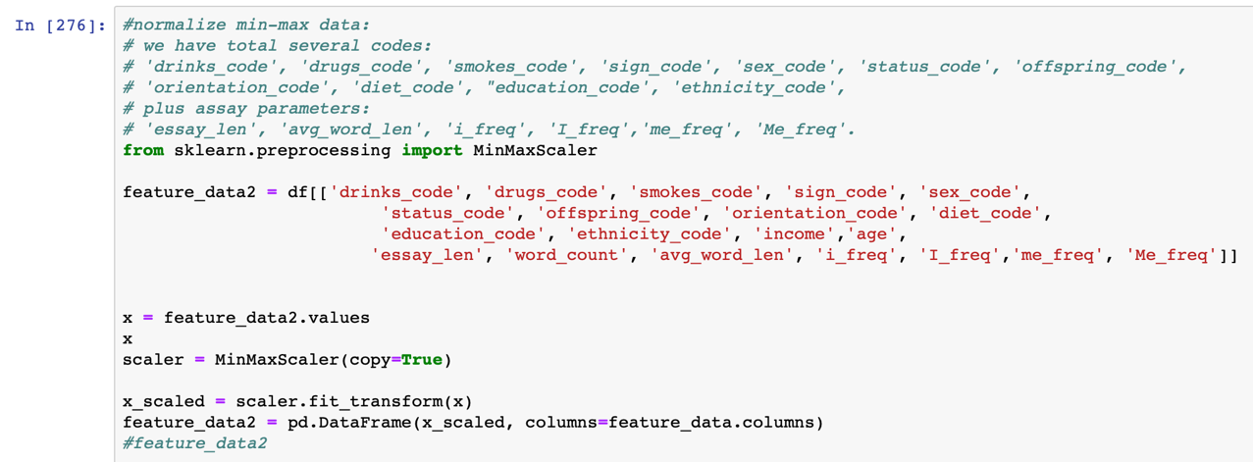
Augmenting data. Normalization

Slide 17
Questions:
Predict sex with education and income levels
K-means;
SVM
Multinomial NB
Linear regression
Predict education level with essay statistics (word counts + essay length + word length + ”i” frequency + “me” frequency)
K-means;
SVM
Multinomial NB
Predict zodiac with essay statistics, K-means
Predict income with personal background and habits using linear regression / K-means
Predict income with essay statistics using linear regression / K-means
Predict age with essay statistics using K-means/linear regression

Slide 18
Predict sex with education and income levels, K-means.
CODE:
%%time
# K-means classifier: predict sex with education level and income
from sklearn.model_selection import train_test_split
from sklearn.neighbors import KNeighborsClassifier
from sklearn.metrics import precision_recall_fscore_support
data = feature_data[['education_code','income']]
target = df[['sex_code']]
data = data.join(target)
data = data.dropna()
training_data, validation_data, training_labels, validation_labels = train_test_split(data[['education_code','income']], data[['sex_code']], test_size = 0.2, random_state = 100)
k_list = []
accuracies = []
metrics = []
for k in range(1,101):
classifier = KNeighborsClassifier(n_neighbors = k)
classifier.fit(training_data, training_labels)
predict_labels = classifier.predict(validation_data)
#print(classifier.score(validation_data, validation_labels))
k_list.append(k)
accuracies.append(classifier.score(validation_data, validation_labels))
metrics.append(precision_recall_fscore_support(validation_labels, predict_labels, average='weighted'))
metrics = np.array(metrics)
# accuracy:
plt.subplot(221)
plt.plot(k_list,accuracies)
plt.xlabel("k")
plt.ylabel("Validation Accuracy")
plt.title("Sex Classifier Accuracy")
plt.grid(True)
# precision:
plt.subplot(222)
plt.plot(k_list,metrics[:,0])
plt.xlabel("k")
plt.ylabel("Validation Precision")
plt.title("Sex Classifier Precision")
plt.grid(True)
# recall:
plt.subplot(223)
plt.plot(k_list,metrics[:,1])
plt.xlabel("k")
plt.ylabel("Validation Recall")
plt.title("Sex Classifier Recall")
plt.grid(True)
# precision:
plt.subplot(224)
plt.plot(k_list,metrics[:,2])
plt.xlabel("k")
plt.ylabel("Validation Fscore")
plt.title("Sex Classifier Fscore")
plt.grid(True)
plt.tight_layout()
plt.show()
print(k_list[15],accuracies[15], metrics[15])
CPU times: user 7min 45s, sys: 4.49 s, total: 7min 50s Wall time: 7min 58s
Overall took 7 min to iterate over 100 k parameters.
Despite the accuracy reaching ~ 0.575-0.59, precision is very unstable.
Theoretically, we have 50% of chance to guess if it is man or woman, so this model is bad

Slide 19
Predict sex with education and income levels, SVC.
CODE:
%%time
from sklearn.svm import SVC
from sklearn.model_selection import train_test_split
from sklearn.metrics import precision_recall_fscore_support
data = feature_data[['education_code','income']]
target = df[['sex_code']]
data = data.join(target)
data = data.dropna()
training_data, validation_data, training_labels, validation_labels = train_test_split(data[['education_code','income']], data[['sex_code']], test_size = 0.2, random_state = 100)
gamma_list = []
accuracies = []
metrics = []
for g in np.arange(0.1, 1.0, 0.1):
classifier = SVC(kernel = 'rbf', gamma=g)
classifier.fit(training_data, training_labels)
predict_labels = classifier.predict(validation_data)
#print(classifier.score(validation_data, validation_labels))
gamma_list.append(g)
accuracies.append(classifier.score(validation_data, validation_labels))
metrics.append(precision_recall_fscore_support(validation_labels, predict_labels, average='weighted'))
metrics = np.array(metrics)
# accuracy:
plt.subplot(221)
plt.plot(gamma_list,accuracies)
plt.xlabel("gamma")
plt.ylabel("Validation Accuracy")
plt.title("Sex Classifier Accuracy")
plt.grid(True)
# precision:
plt.subplot(222)
plt.plot(gamma_list,metrics[:,0])
plt.xlabel("gamma")
plt.ylabel("Validation Precision")
plt.title("Sex Classifier Precision")
plt.grid(True)
# recall:
plt.subplot(223)
plt.plot(gamma_list,metrics[:,1])
plt.xlabel("gamma")
plt.ylabel("Validation Recall")
plt.title("Sex Classifier Recall")
plt.grid(True)
# precision:
plt.subplot(224)
plt.plot(gamma_list,metrics[:,2])
plt.xlabel("gamma")
plt.ylabel("Validation Fscore")
plt.title("Sex Classifier Fscore")
plt.grid(True)
plt.tight_layout()
plt.show()
#print(k_list[15],accuracies[15], metrics[15])
CPU times: user 7min 3s, sys: 4.5 s, total: 7min 7s Wall time: 7min 14s
Overall took 7 min to iterate over 10 gamma parameters.
Theoretically, we have 50% of chance to guess if it is man or woman, then this model is bad

Slide 20
Predict sex with education and income levels, Linear regression.
CODE:
%%time
from sklearn.linear_model import LinearRegression
from sklearn.model_selection import train_test_split
from sklearn.metrics import precision_recall_fscore_support
data = feature_data[['education_code','income']]
target = df[['sex_code']]
data = data.join(target)
data = data.dropna()
training_data, validation_data, training_labels, validation_labels = train_test_split(data[['education_code','income']], data[['sex_code']], test_size = 0.2, random_state = 100)
model = LinearRegression()
model.fit(training_data,training_labels)
print('Train Score:', model.score(training_data,training_labels))
print('Test Score:', model.score(validation_data, validation_labels))
Train Score: 0.009895249326099975
Test Score: 0.004209788181156693
CPU times: user 55.9 ms, sys: 17 ms, total: 72.9 ms Wall time: 73 ms
Linear regression failed to build adequate model.
Result indicates that there is non-linear relationship between sex and education + income features

Slide 21
Predict sex with education and income levels, Multinomial NB.
CODE:
%%time
# BM classifier: predict sex with education level and income using normalized data
from sklearn.naive_bayes import MultinomialNB
from sklearn.model_selection import train_test_split
data = feature_data2[['education_code','income']]
target = df[['sex_code']]
data = data.join(target)
data = data.dropna()
training_data, validation_data, training_labels, validation_labels = train_test_split(data[['education_code','income']], data[['sex_code']], test_size = 0.2, random_state = 100)
classifier = MultinomialNB()
classifier.fit(training_data,training_labels)
print(classifier.score(validation_data,validation_labels))
Accuracy: 0.5910998340977848
CPU times: user 58.8 ms, sys: 32.8 ms, total: 91.6 ms Wall time: 70.2 ms
Again, model is not much better then random guess ~ 0.5.

Slide 22
Predict sex with education and income levels, conclusion
All tested classifiers (K-means, SVC, MNB, LinReg) failed to build model which would perform significantly better then chance.
This result may indicate that there is no clear income gap / education gap between genders in San Francisco area. All genders evenly distributed across the studied features in all tested categories.
In general I noticed, that multinomial NB performed much faster then all other tested classifiers; however K-means tested 100 parameters for 7 min giving nice representation of model performance across multiple tunings

Slide 23
Predict education level with all essay statistics: word counts, essay length, average word length, ”i” frequency and “me” frequency, K-means
CODE:
*
%%time
#predict education level with essay text word counts (+/- essay length and word length)
from sklearn.model_selection import train_test_split
from sklearn.neighbors import KNeighborsClassifier
from sklearn.metrics import precision_recall_fscore_support
data = feature_data[['essay_len','word_count','avg_word_len','i_freq', 'I_freq','me_freq', 'Me_freq']]
target = df[['education_code']]
data = data.join(target)
data = data.dropna()
training_data, validation_data, training_labels, validation_labels = train_test_split(data[['essay_len','word_count','avg_word_len','i_freq', 'I_freq','me_freq', 'Me_freq']], data[['education_code']], test_size = 0.2, random_state = 101)
k_list = []
accuracies = []
metrics = []
for k in range(1,101):
classifier = KNeighborsClassifier(n_neighbors = k)
classifier.fit(training_data, training_labels)
predict_labels = classifier.predict(validation_data)
#print(classifier.score(validation_data, validation_labels))
k_list.append(k)
accuracies.append(classifier.score(validation_data, validation_labels))
metrics.append(precision_recall_fscore_support(validation_labels, predict_labels, average='weighted'))
metrics = np.array(metrics)
# accuracy:
plt.subplot(221)
plt.plot(k_list,accuracies)
plt.xlabel("k")
plt.ylabel("Validation Accuracy")
plt.title("Sex Classifier Accuracy")
plt.grid(True)
# precision:
plt.subplot(222)
plt.plot(k_list,metrics[:,0])
plt.xlabel("k")
plt.ylabel("Validation Precision")
plt.title("Sex Classifier Precision")
plt.grid(True)
# recall:
plt.subplot(223)
plt.plot(k_list,metrics[:,1])
plt.xlabel("k")
plt.ylabel("Validation Recall")
plt.title("Sex Classifier Recall")
plt.grid(True)
# precision:
plt.subplot(224)
plt.plot(k_list,metrics[:,2])
plt.xlabel("k")
plt.ylabel("Validation Fscore")
plt.title("Sex Classifier Fscore")
plt.grid(True)
plt.tight_layout()
plt.show()
print(k_list[76],accuracies[76], metrics[76])
CPU times: user 2min 41s, sys: 1.65 s, total: 2min 43s Wall time: 2min 43s
I like this model. Recall is above 0.73, with variable precision from ~0.6 - 0.7
Overall model performs better then random (0.33).
*Apologies for the plot titles – there is a typo in the code

Slide 24
Predict education level with only word counts, K-means
*
CODE:
%%time
#predict education level with essay text word counts (+/- essay length and word length)
from sklearn.model_selection import train_test_split
from sklearn.neighbors import KNeighborsClassifier
from sklearn.metrics import precision_recall_fscore_support
data = feature_data[['word_count']]
target = df[['education_code']]
data = data.join(target)
data = data.dropna()
training_data, validation_data, training_labels, validation_labels = train_test_split(data[['word_count']], data[['education_code']], test_size = 0.2, random_state = 101)
k_list = []
accuracies = []
metrics = []
for k in range(1,101):
classifier = KNeighborsClassifier(n_neighbors = k)
classifier.fit(training_data, training_labels)
predict_labels = classifier.predict(validation_data)
#print(classifier.score(validation_data, validation_labels))
k_list.append(k)
accuracies.append(classifier.score(validation_data, validation_labels))
metrics.append(precision_recall_fscore_support(validation_labels, predict_labels, average='weighted'))
metrics = np.array(metrics)
# accuracy:
plt.subplot(221)
plt.plot(k_list,accuracies)
plt.xlabel("k")
plt.ylabel("Validation Accuracy")
plt.title("Sex Classifier Accuracy")
plt.grid(True)
# precision:
plt.subplot(222)
plt.plot(k_list,metrics[:,0])
plt.xlabel("k")
plt.ylabel("Validation Precision")
plt.title("Sex Classifier Precision")
plt.grid(True)
# recall:
plt.subplot(223)
plt.plot(k_list,metrics[:,1])
plt.xlabel("k")
plt.ylabel("Validation Recall")
plt.title("Sex Classifier Recall")
plt.grid(True)
# precision:
plt.subplot(224)
plt.plot(k_list,metrics[:,2])
plt.xlabel("k")
plt.ylabel("Validation Fscore")
plt.title("Sex Classifier Fscore")
plt.grid(True)
plt.tight_layout()
plt.show()
print(k_list[76],accuracies[76], metrics[76])
CPU times: user 1min 17s, sys: 1.75 s, total: 1min 19s Wall time: 1min 20s
I like this model less then previous. Recall is above 0.73, with lower precision, variable from ~0.5 - 0.6
Overall model performs better then random (0.33), but less good then the K-means model based on all essay statistics, as concluded based on precision.
*Apologies for the plot titles – there is a typo in the code

Slide 25
Predict education level with only word counts, Multinomial NB
With all essay stats, code:
%%time
# BM classifier: predict education level with essay text word counts (+ essay length and word length)
from sklearn.naive_bayes import MultinomialNB
from sklearn.model_selection import train_test_split
from sklearn.metrics import precision_recall_fscore_support
data = feature_data2[['essay_len','word_count','avg_word_len','i_freq', 'I_freq','me_freq', 'Me_freq']]
target = df[['education_code']]
data = data.join(target)
data = data.dropna()
training_data, validation_data, training_labels, validation_labels = train_test_split(data[['essay_len','word_count','avg_word_len','i_freq', 'I_freq','me_freq', 'Me_freq']], data[['education_code']], test_size = 0.2, random_state = 101)
classifier = MultinomialNB()
classifier.fit(training_data,training_labels)
print(classifier.score(validation_data,validation_labels))
predicted_labels = classifier.predict(validation_data)
print(classifier.score(validation_data,validation_labels))
metrics = precision_recall_fscore_support(validation_labels, predicted_labels, average='weighted')
print(metrics)
CPU times: user 64.2 ms, sys: 9.06 ms, total: 73.2 ms Wall time: 72 ms
Precision = 0.53373, Recall = 0.730572, F1-score = 0.61683.
With only word counts, code:
%%time
# BM classifier: predict education level with essay text word counts
from sklearn.naive_bayes import MultinomialNB
from sklearn.model_selection import train_test_split
from sklearn.metrics import precision_recall_fscore_support
data = feature_data2[['word_count']]
target = df[['education_code']]
data = data.join(target)
data = data.dropna()
training_data, validation_data, training_labels, validation_labels = train_test_split(data[['word_count']], data[['education_code']], test_size = 0.2, random_state = 101)
classifier = MultinomialNB()
classifier.fit(training_data,training_labels)
predicted_labels = classifier.predict(validation_data)
print(classifier.score(validation_data,validation_labels))
metrics = precision_recall_fscore_support(validation_labels, predicted_labels, average='weighted')
print(metrics)
CPU times: user 60.5 ms, sys: 12.9 ms, total: 73.5 ms Wall time: 58.7 ms
Precision = 0.5266, Recall = 0.7256758, F1-score = 0.610317.
Both models perform similar to each other, indicating that additional assay parameters had limited predictive power, then just word count itself;
Though MNB performed faster then K-means, Precision of K-means model with all essay statistics is higher on average then of MNB.

Slide 26
Predict education level with selected essay statistics: essay length, average word length, ”i” frequency, “me” frequency. SVM classifier
CODE:
%%time
from sklearn.svm import SVC
from sklearn.model_selection import train_test_split
from sklearn.metrics import precision_recall_fscore_support
data = feature_data[['essay_len','avg_word_len','i_freq','me_freq']]
target = df[['education_code']]
data = data.join(target)
data = data.dropna()
training_data, validation_data, training_labels, validation_labels = train_test_split(data[['essay_len','avg_word_len','i_freq','me_freq']], data[['education_code']], test_size = 0.2, random_state = 101)
gamma_list = []
accuracies = []
metrics = []
for g in np.arange(1, 10, 1):
classifier = SVC(kernel = 'rbf', gamma=g)
classifier.fit(training_data, training_labels)
predict_labels = classifier.predict(validation_data)
#print(classifier.score(validation_data, validation_labels))
gamma_list.append(g)
accuracies.append(classifier.score(validation_data, validation_labels))
metrics.append(precision_recall_fscore_support(validation_labels, predict_labels, average='weighted'))
metrics = np.array(metrics)
# accuracy:
plt.subplot(221)
plt.plot(gamma_list,accuracies)
plt.xlabel("gamma")
plt.ylabel("Validation Accuracy")
plt.title("Sex Classifier Accuracy")
plt.grid(True)
# precision:
plt.subplot(222)
plt.plot(gamma_list,metrics[:,0])
plt.xlabel("gamma")
plt.ylabel("Validation Precision")
plt.title("Sex Classifier Precision")
plt.grid(True)
# recall:
plt.subplot(223)
plt.plot(gamma_list,metrics[:,1])
plt.xlabel("gamma")
plt.ylabel("Validation Recall")
plt.title("Sex Classifier Recall")
plt.grid(True)
# precision:
plt.subplot(224)
plt.plot(gamma_list,metrics[:,2])
plt.xlabel("gamma")
plt.ylabel("Validation Fscore")
plt.title("Sex Classifier Fscore")
plt.grid(True)
plt.tight_layout()
plt.show()
#print(k_list[15],accuracies[15], metrics[15])
*
CPU times: user 33min 56s, sys: 21.4 s, total: 34min 18s Wall time: 1h 31min 8s
Modelling is extremely slow and reached comparable accuracy with K-means at certain gamma parameters. I do not see the benefits of using SVM
*Apologies for the plot titles – there is a typo in the code

Slide 27
Predict education level with essay statistics, conclusion
All tested classifiers (K-means, SVC, MNB) performed better then chance. Linear regression failed to build adequate model (not shown).
Building model based on all essay statistics (essay length + word count + average word length + ”i” frequency + “me” frequency) gave better results then just on word count, as governed by precision score of K-means and MNB results
All together that may indicate that there is a clear difference in writing styles between college-level, high school level and drop-out participants. It may be a reflection of certain themes people talk, their experiences, their choice of words, or simply generation differences: college-level people are older then high-schoolers in general.

Slide 28
Predict zodiac based on essay statistics, K-means
CODE:
%%time
#predict zodiac with essay text word counts (+ essay length and word length)
from sklearn.model_selection import train_test_split
from sklearn.neighbors import KNeighborsClassifier
from sklearn.metrics import precision_recall_fscore_support
data = feature_data[['essay_len','word_count','avg_word_len','i_freq', 'I_freq','me_freq', 'Me_freq']]
target = df[['sign_code']]
data = data.join(target)
data = data.dropna()
training_data, validation_data, training_labels, validation_labels = train_test_split(data[['essay_len','word_count','avg_word_len','i_freq', 'I_freq','me_freq', 'Me_freq']], data[['sign_code']], test_size = 0.2, random_state = 10)
k_list = []
accuracies = []
metrics = []
for k in range(1,101):
classifier = KNeighborsClassifier(n_neighbors = k)
classifier.fit(training_data, training_labels)
predict_labels = classifier.predict(validation_data)
#print(classifier.score(validation_data, validation_labels))
k_list.append(k)
accuracies.append(classifier.score(validation_data, validation_labels))
metrics.append(precision_recall_fscore_support(validation_labels, predict_labels, average='weighted'))
metrics = np.array(metrics)
# accuracy:
plt.subplot(221)
plt.plot(k_list,accuracies)
plt.xlabel("k")
plt.ylabel("Validation Accuracy")
plt.title("Zodiac Classifier Accuracy")
plt.grid(True)
# precision:
plt.subplot(222)
plt.plot(k_list,metrics[:,0])
plt.xlabel("k")
plt.ylabel("Validation Precision")
plt.title("Zodiac Classifier Precision")
plt.grid(True)
# recall:
plt.subplot(223)
plt.plot(k_list,metrics[:,1])
plt.xlabel("k")
plt.ylabel("Validation Recall")
plt.title("Zodiac Classifier Recall")
plt.grid(True)
# precision:
plt.subplot(224)
plt.plot(k_list,metrics[:,2])
plt.xlabel("k")
plt.ylabel("Validation Fscore")
plt.title("Zodiac Classifier Fscore")
plt.grid(True)
plt.tight_layout()
plt.show()
CPU times: user 2min 47s, sys: 2.05 s, total: 2min 49s Wall time: 2min 51s
K-means did not find patterns in zodiacs of participants based on essay stats.

Slide 29
Predict income based on personal background and habits, K-means
CODE:
%%time
#predict income with drinks, smokes, drugs, sex, offspring, diet, status, education, age
from sklearn.model_selection import train_test_split
from sklearn.neighbors import KNeighborsClassifier
from sklearn.metrics import precision_recall_fscore_support
data = feature_data[['drinks_code', 'drugs_code', 'smokes_code','status_code', 'offspring_code', 'diet_code', 'education_code', 'age']]
target = df[['income']]
data = data.join(target)
data = data.dropna()
training_data, validation_data, training_labels, validation_labels = train_test_split(data[['drinks_code', 'drugs_code', 'smokes_code','status_code', 'offspring_code', 'diet_code', 'education_code','age']], data[['income']], test_size = 0.2, random_state = 10)
k_list = []
accuracies = []
metrics = []
for k in range(1,101):
classifier = KNeighborsClassifier(n_neighbors = k)
classifier.fit(training_data, training_labels)
predict_labels = classifier.predict(validation_data)
#print(classifier.score(validation_data, validation_labels))
k_list.append(k)
accuracies.append(classifier.score(validation_data, validation_labels))
metrics.append(precision_recall_fscore_support(validation_labels, predict_labels, average='weighted'))
metrics = np.array(metrics)
# accuracy:
plt.subplot(221)
plt.plot(k_list,accuracies)
plt.xlabel("k")
plt.ylabel("Validation Accuracy")
plt.title("Income Classifier Accuracy")
plt.grid(True)
# precision:
plt.subplot(222)
plt.plot(k_list,metrics[:,0])
plt.xlabel("k")
plt.ylabel("Validation Precision")
plt.title("Income Classifier Precision")
plt.grid(True)
# recall:
plt.subplot(223)
plt.plot(k_list,metrics[:,1])
plt.xlabel("k")
plt.ylabel("Validation Recall")
plt.title("Income Classifier Recall")
plt.grid(True)
# precision:
plt.subplot(224)
plt.plot(k_list,metrics[:,2])
plt.xlabel("k")
plt.ylabel("Validation Fscore")
plt.title("Income Classifier Fscore")
plt.grid(True)
plt.tight_layout()
plt.show()
CPU times: user 1min 22s, sys: 26.6 s, total: 1min 48s Wall time: 1min 56s
Overall, K-means finds good model to predict income, with best accuracy 0.75

Slide 30
Predict income based on personal background and habits, Linear regression
CODE:
%%time
#predict income with drinks, smokes, drugs, sex, offspring, diet, status, education, age, Linear regression
from sklearn.model_selection import train_test_split
from sklearn.linear_model import LinearRegression
from sklearn.metrics import precision_recall_fscore_support
data = feature_data[['drinks_code', 'drugs_code', 'smokes_code','status_code', 'offspring_code', 'diet_code', 'education_code', 'age']]
target = df[['income']]
data = data.join(target)
data = data.dropna()
training_data, validation_data, training_labels, validation_labels = train_test_split(data[['drinks_code', 'drugs_code', 'smokes_code','status_code', 'offspring_code', 'diet_code', 'education_code','age']], data[['income']], test_size = 0.2, random_state = 10)
model = LinearRegression()
model.fit(training_data,training_labels)
print('Train Score:', model.score(training_data,training_labels))
print('Test Score:', model.score(validation_data, validation_labels))
Train Score: 0.013800861845689294
Test Score: 0.018855477332165638
CPU times: user 48.2 ms, sys: 10.4 ms, total: 58.6 ms Wall time: 43.8 ms
Overall Linear regression fails to identify patterns in income based on personal data

Slide 31
Predict income based on essay statistics, K-means
CODE:
%%time
#predict income with essay text word counts (+ essay length and word length)
from sklearn.model_selection import train_test_split
from sklearn.neighbors import KNeighborsClassifier
from sklearn.metrics import precision_recall_fscore_support
data = feature_data[['essay_len','word_count','avg_word_len','i_freq', 'I_freq','me_freq', 'Me_freq']]
target = df[['income']]
data = data.join(target)
data = data.dropna()
training_data, validation_data, training_labels, validation_labels = train_test_split(data[['essay_len','word_count','avg_word_len','i_freq', 'I_freq','me_freq', 'Me_freq']], data[['income']], test_size = 0.2, random_state = 10)
k_list = []
accuracies = []
metrics = []
for k in range(1,101):
classifier = KNeighborsClassifier(n_neighbors = k)
classifier.fit(training_data, training_labels)
predict_labels = classifier.predict(validation_data)
#print(classifier.score(validation_data, validation_labels))
k_list.append(k)
accuracies.append(classifier.score(validation_data, validation_labels))
metrics.append(precision_recall_fscore_support(validation_labels, predict_labels, average='weighted'))
metrics = np.array(metrics)
# accuracy:
plt.subplot(221)
plt.plot(k_list,accuracies)
plt.xlabel("k")
plt.ylabel("Validation Accuracy")
plt.title("Income Classifier Accuracy")
plt.grid(True)
# precision:
plt.subplot(222)
plt.plot(k_list,metrics[:,0])
plt.xlabel("k")
plt.ylabel("Validation Precision")
plt.title("Income Classifier Precision")
plt.grid(True)
# recall:
plt.subplot(223)
plt.plot(k_list,metrics[:,1])
plt.xlabel("k")
plt.ylabel("Validation Recall")
plt.title("Income Classifier Recall")
plt.grid(True)
# precision:
plt.subplot(224)
plt.plot(k_list,metrics[:,2])
plt.xlabel("k")
plt.ylabel("Validation Fscore")
plt.title("Income Classifier Fscore")
plt.grid(True)
plt.tight_layout()
plt.show()
CPU times: user 3min 31s, sys: 2.68 s, total: 3min 34s Wall time: 3min 36s
Overall good model, with accuracy higher then 0.8.

Slide 32
Predict income based on essay statistics and age, Linear regression
CODE:
Train Score: 0.000950420580824507
Test Score: -0.0007859454657384024
CPU times: user 78.6 ms, sys: 14.2 ms, total: 92.8 ms Wall time: 69.3 ms
Overall Linear regression fails to identify patterns in income based on personal data
%%time
#predict income with essay statistics, age, Linear regression
from sklearn.model_selection import train_test_split
from sklearn.linear_model import LinearRegression
from sklearn.metrics import precision_recall_fscore_support
data = feature_data[['essay_len','word_count','avg_word_len','i_freq', 'I_freq','me_freq', 'Me_freq','age']]
target = df[['income']]
data = data.join(target)
data = data.dropna()
training_data, validation_data, training_labels, validation_labels = train_test_split(data[['essay_len','word_count','avg_word_len','i_freq', 'I_freq','me_freq', 'Me_freq','age']], data[['income']], test_size = 0.2, random_state = 15)
model = LinearRegression()
model.fit(training_data,training_labels)
print('Train Score:', model.score(training_data,training_labels))
print('Test Score:', model.score(validation_data, validation_labels))

Slide 33
Predict zodiac based on essay stats, conclusion
Essay statistics (word counts + essay length + word length + ”i” frequency + “me” frequency) is bad predictor of zodiac signs.
Even modelling based on personal background and habits (drinks, drugs, smokes, status, offspring, diet, education, age) did not improve the prediction scores (not shown).
Results may indicate that astrology is fake and there are no real patterns in peoples behavior based on star composition at the day of birth.

Slide 34
Predict income based on essay statistics or personal background and habits, conclusion
Essay statistics (word counts + essay length + word length + ”i” frequency + “me” frequency) is a very good predictor of income.
Personal background and habits (drinks, drugs, smokes, status, offspring, diet, education, age) is a good predictor of income.
Results indicate, that there are clear patterns in writing styles and personal habits of people with different income. The first statement is quiet interesting, as suggests that wealthy/poor people may use very similar word lexicon. Does it also indicate, that wealthy people study in very similar schools using very similar books?
Personal habits are good predictors of an income. That is quiet intuitively obvious, as wealthy people often have enough time and money to take care of them: they exercise, do not do drugs, do not smoke, and etc.

Slide 35
Predict age based on essay statistics, K-means
CODE:
%%time
#predict age with essay text word counts (+ essay length and word length)
from sklearn.model_selection import train_test_split
from sklearn.neighbors import KNeighborsClassifier
from sklearn.metrics import precision_recall_fscore_support
data = feature_data[['essay_len','word_count','avg_word_len','i_freq', 'I_freq','me_freq', 'Me_freq']]
target = df[['age']]
data = data.join(target)
data = data.dropna()
training_data, validation_data, training_labels, validation_labels = train_test_split(data[['essay_len','word_count','avg_word_len','i_freq', 'I_freq','me_freq', 'Me_freq']], data[['age']], test_size = 0.2, random_state = 10)
k_list = []
accuracies = []
metrics = []
for k in range(1,101):
classifier = KNeighborsClassifier(n_neighbors = k)
classifier.fit(training_data, training_labels)
predict_labels = classifier.predict(validation_data)
#print(classifier.score(validation_data, validation_labels))
k_list.append(k)
accuracies.append(classifier.score(validation_data, validation_labels))
metrics.append(precision_recall_fscore_support(validation_labels, predict_labels, average='weighted'))
metrics = np.array(metrics)
# accuracy:
plt.subplot(221)
plt.plot(k_list,accuracies)
plt.xlabel("k")
plt.ylabel("Validation Accuracy")
plt.title("Age Classifier Accuracy")
plt.grid(True)
# precision:
plt.subplot(222)
plt.plot(k_list,metrics[:,0])
plt.xlabel("k")
plt.ylabel("Validation Precision")
plt.title("Age Classifier Precision")
plt.grid(True)
# recall:
plt.subplot(223)
plt.plot(k_list,metrics[:,1])
plt.xlabel("k")
plt.ylabel("Validation Recall")
plt.title("Age Classifier Recall")
plt.grid(True)
# precision:
plt.subplot(224)
plt.plot(k_list,metrics[:,2])
plt.xlabel("k")
plt.ylabel("Validation Fscore")
plt.title("Age Classifier Fscore")
plt.grid(True)
plt.tight_layout()
plt.show()
CPU times: user 3min 30s, sys: 2.8 s, total: 3min 33s Wall time: 3min 35s
K-means fails to predict age based on essay statistics

Slide 36
Predict age based on essay statistics, Linear regression
CODE:
%%time
#predict age with essay stats, Linear regression
from sklearn.model_selection import train_test_split
from sklearn.linear_model import LinearRegression
from sklearn.metrics import precision_recall_fscore_support
data = feature_data[['essay_len','word_count','avg_word_len','i_freq', 'I_freq','me_freq', 'Me_freq']]
target = df[['age']]
data = data.join(target)
data = data.dropna()
training_data, validation_data, training_labels, validation_labels = train_test_split(data[['essay_len','word_count','avg_word_len','i_freq', 'I_freq','me_freq', 'Me_freq']], data[['age']], test_size = 0.2, random_state = 15)
model = LinearRegression()
model.fit(training_data,training_labels)
print('Train Score:', model.score(training_data,training_labels))
print('Test Score:', model.score(validation_data, validation_labels))
Train Score: 0.014873868712280025
Test Score: 0.017351764064907016
CPU times: user 69.2 ms, sys: 52.6 ms, total: 122 ms Wall time: 111 ms
Linear regression is unable to predict age based on essay stats

Slide 37
Predict age based on essay statistics, conclusion
Essay statistics (word counts + essay length + word length + ”i” frequency + “me” frequency) is a bad predictor of age.
Additional inspection of other features (personal habits and background) did not improve the modelling, neither serve as predictors of age separately (not shown)
These results indicate, that its not enough just to age to gain better writing/education/wisdom level, rather its education what matters. This observation may go against common belief that more older person has more respectful in his decisions).
In part above conclusion agrees with previous observation, that essay stats are good predictors of education level.

Slide 38
Overall conclusions and next steps
Among several tested classifiers: K-means, multinomial NB, linear regression and SVM – K-means and multinomial NB performed best in terms of time and effectiveness; though multinomial NB deals only with min-max normalized dataset, thus prone to outlier effect, while K-means easily processes z-score standardized data. That’s reason was the primary reason for downstream usage of K-means as an algorithm of choice.
Concerning the dataset, I found quiet unexpected and intriguing the predictive power of essay statistics on income of the participants. That indicates that certain writing patterns exist which segregate people based on their income, as well as education (which is more obvious).
Next steps may include building multinomial NB classifier based on total vocabulary of people with different income/education levels, which may be useful to classify people hanging in Okcupid based on their essays…☺

